Slide 1

Cell tower growth in the world
Shakil ahmed (Group – 8)

Slide 2
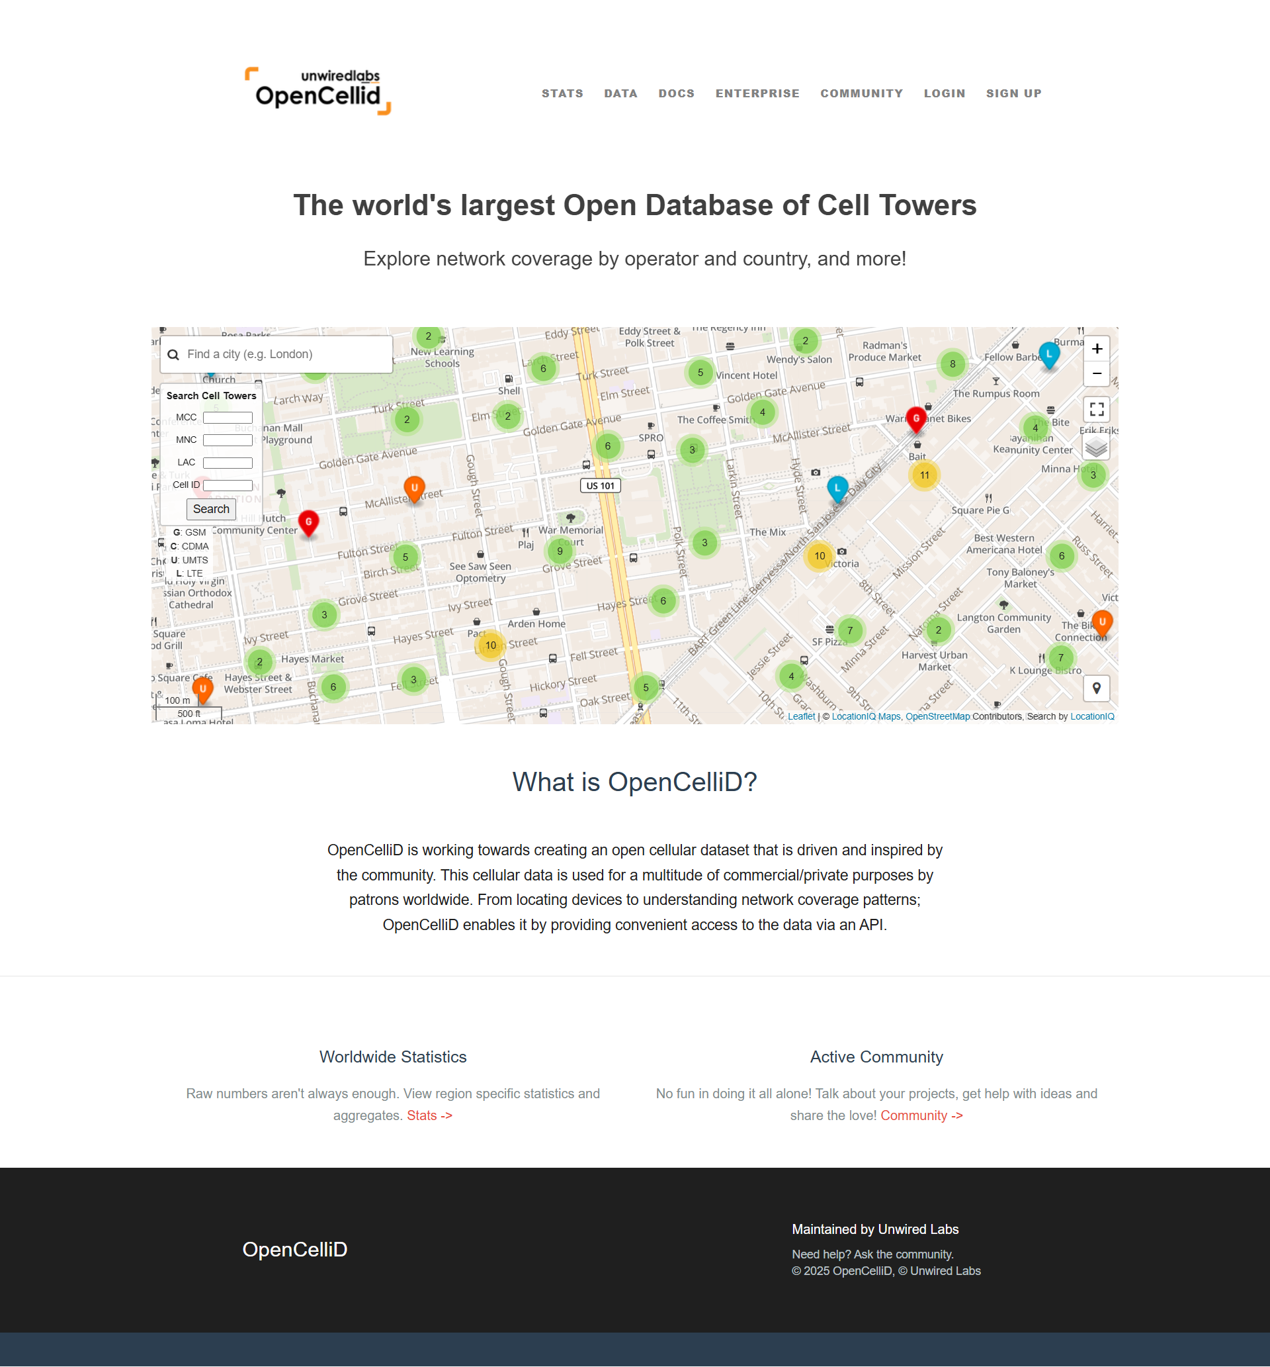
Data
Overview:
46 M global cell‑tower records (OpenCellID).
Official national population statistics for demographic context.
Preprocessing:
Dropped invalid geo coordinates & timestamps; label missing operators 'Unknown’, and operators with fewer than 1000 towers are transformed to ’Others.’
Timestamps are transformed from Unix time to datetime objects.
Integrated population data.
Standardize country names; merge latest population figures.
Down sample to ≤ 50 k points for fluid performance.
https://www.opencellid.org/zoom=16lat=37.77889lon=-122.41942

Slide 3
Task
Overview
Comparison: comparisons between countries, operators, and technologies.
Temporal Analysis: Time-series visualizations like cumulative growth trends and operator specific growth patterns.
Correlation: how infrastructure aligns with population densities.

Slide 4
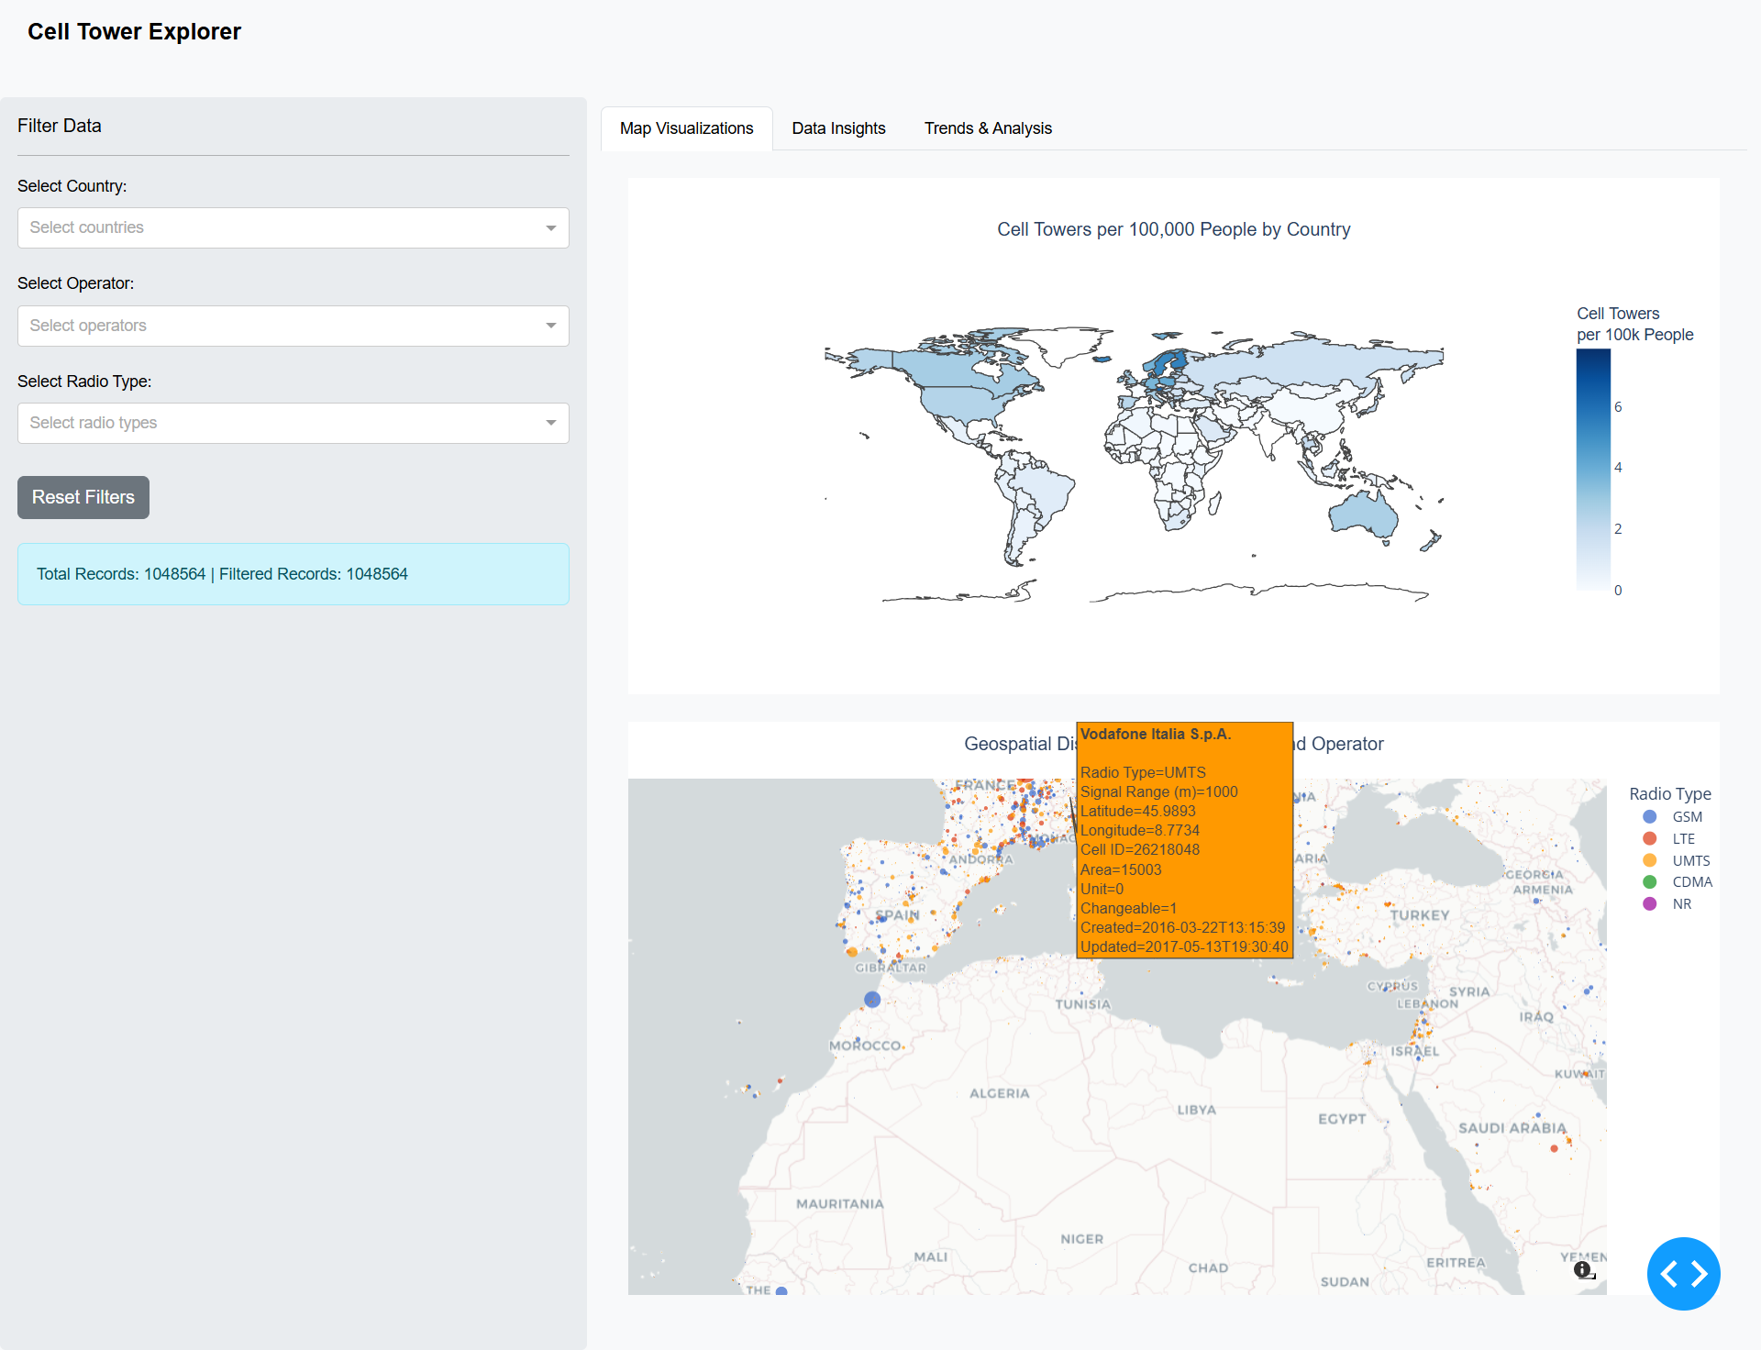

Slide 5
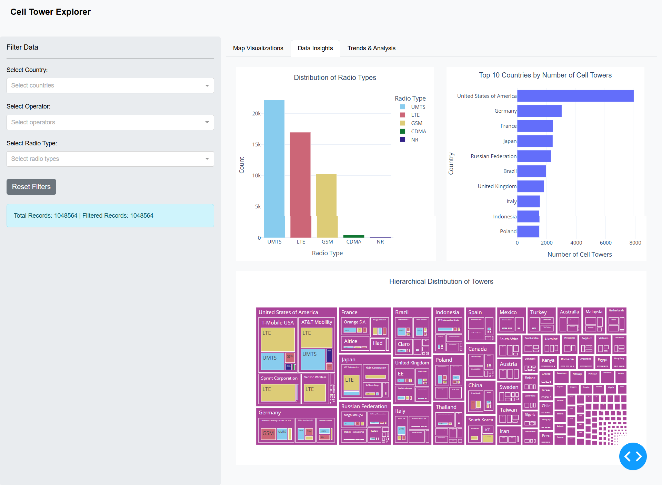

Slide 6
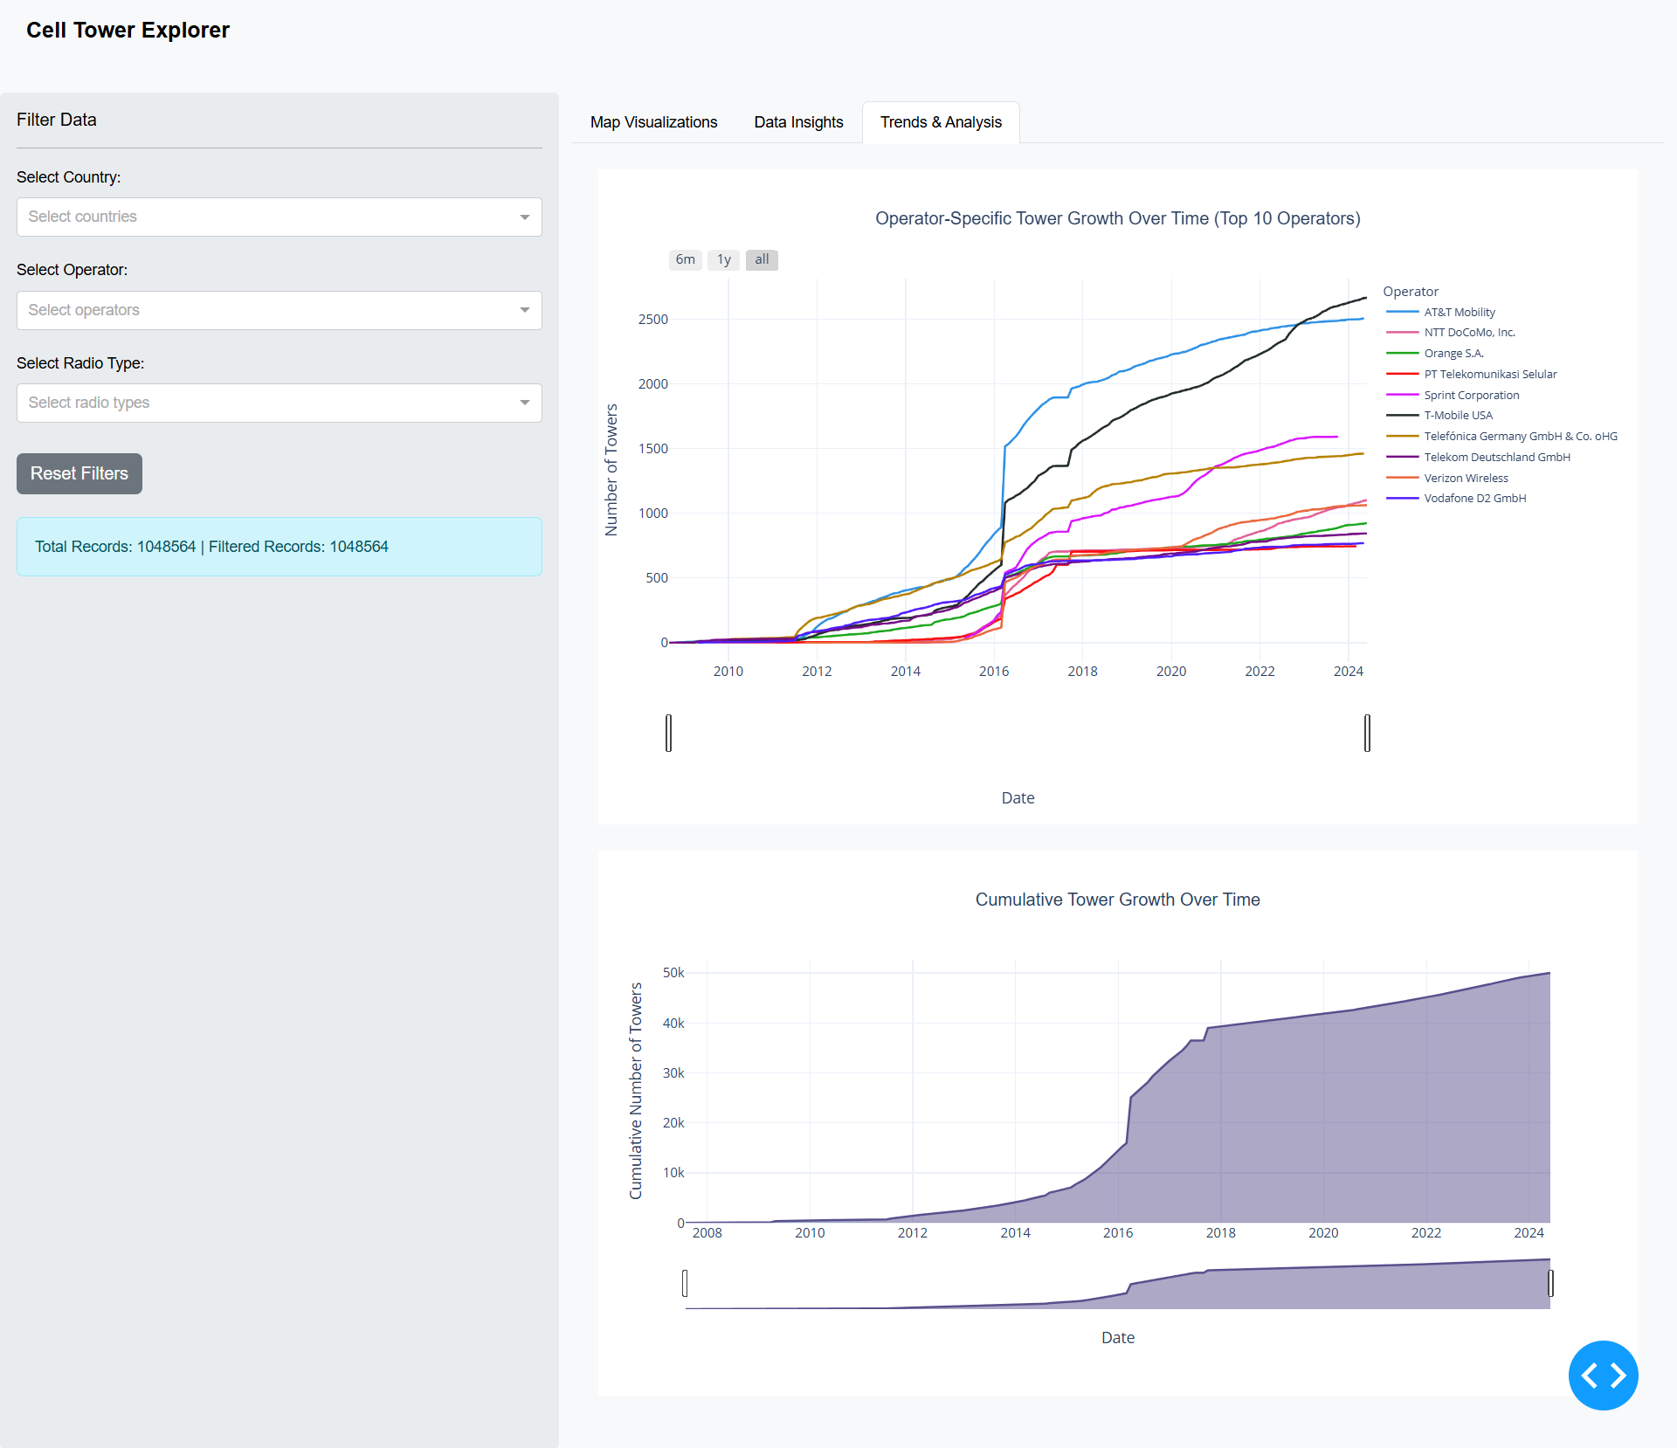

Slide 7
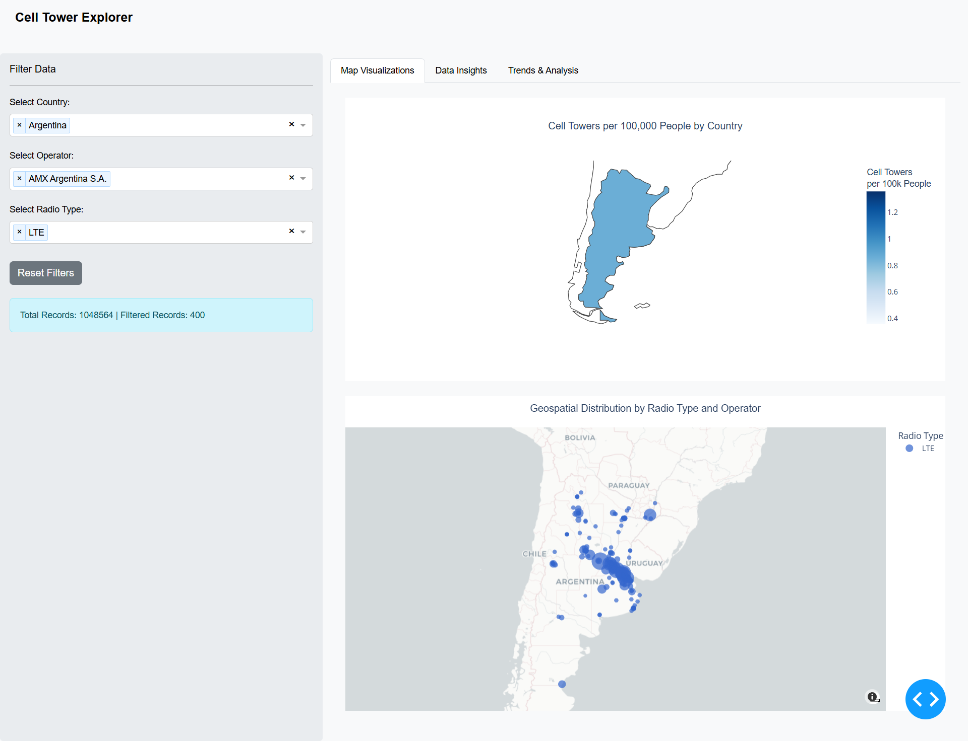

Slide 8
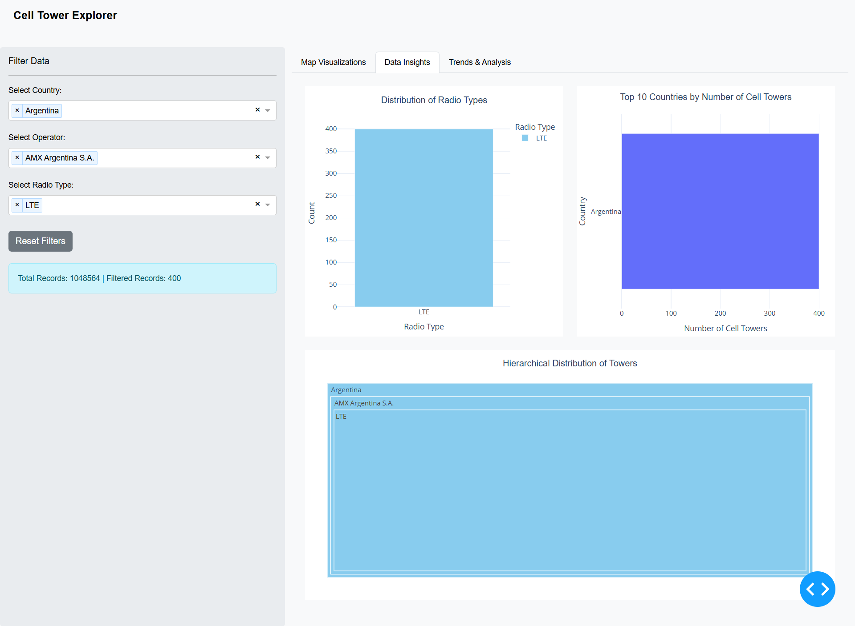

Slide 9
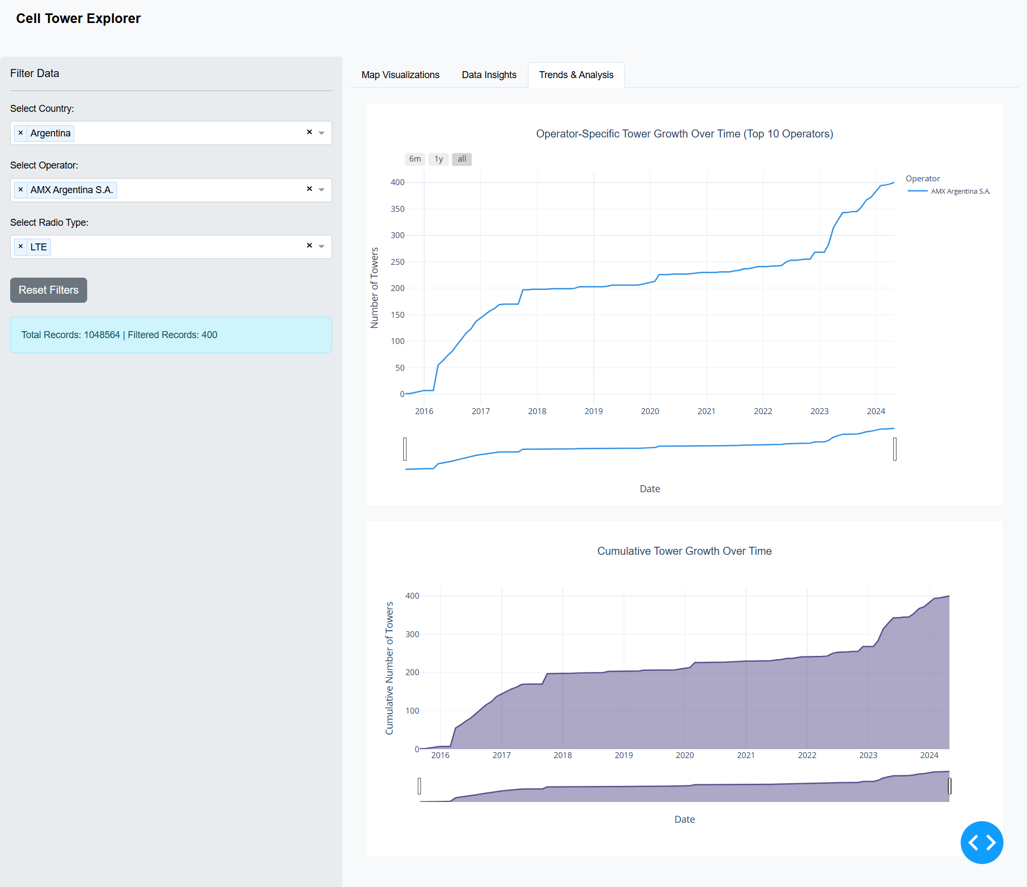

Slide 10
References
OpenCellID. Opencellid dataset. https://www.opencellid.org/zoom=16lat=37.77889lon=-122.41942 , 2023, Accessed: 2024-10-15.

